Slide 1
The modeling process

Slide 2
Outline
What is a mathematical model?
Typical model classification
Relevant definitions
The modeling process
Application areas
Model building steps
Relevant issues to consider for model development
Some applications of modeling

Slide 3
I. What is a mathematical model?

Slide 4
What is a model?
It depends who you ask ...
Genetist: the mouse family Ts65Dn is a model of human trisomy 21 (Down syndrome)
Chemist: a sketch containing dots (chemical compounds) and arrows (chemical reactions) is a model of a chemical reaction network
Engineer: the same reaction network can be described by a set of non-linear equations (if the system is in steady state) or by a differential/algebraic equation system (DAE system) if the network is not in steady-state
It is an abstract representation of objects or processes that explain some of their characteristics

Slide 5
Models in Process Engineering
What is a mathematical model in process engineering?
A mathematical representation of a process built to accomplish a given purpose
What is a process?
A series of interrelated operations (tasks) that, together, transform input streams into output streams. Output streams differ from input streams in their thermodynamic state (pressure, temperature, composition or state of matter) and magnitude

Slide 6
II. Typical model classification

Slide 7
Model classification
Class | Characteristics
First principles model | Model equations have been derived from fundamental science laws (for example, conservation principles)
Empirical or black box model | Model equations were chosen to represent well the relationship between input and output variables

Slide 8
Model classification
Class | Characteristics
Dynamic model | Some model variables change with time
Static or steady state model | No model variable change with time

Slide 9
Model classification
Class | Characteristics
Continuos model | The model is applicable at any time value within the specified time range
Discrete model | The model is applicable only at given time values
Hybrid model | Part of the model is continuous and part is discrete

Slide 10
Model classification
Class | Characteristics
Distributed parameter model | Models that include more than one independent variable (for example, time and position). The model is described by partial differential equations (PDE).
Lumped parameter model | Models that include only one independent variable (for example time). The model is describe by ordinary differential equations.

Slide 11
Model classification
Class | Characteristics
Deterministic model | No variable is random or stochastic
Stochastic | Some variables are random or stochastic

Slide 12
III. Important definitions

Slide 13
State variables
The minimum set of variables that completely characterize the state of a given system. If we know the state at a given time, the mathematical model and the future values of the input variables, we can know the state of the system at any given time in the future. They are the differential variables in the ODE system.
These variables appear naturally in the accumulation term in the mass and energy balances.
Example: concentration of a given compound or temperature in a bioreactor.

Slide 14
Input variables
Are those variables that affect the state of the system and define how the system will evolve.
Many input variables are manipulated to control the system.
Examples: flowrate, temperature and composition of the inlet streams.

Slide 15
Parameters
Physical, chemical and engineering constants that appear in the model. Their values are needed to solve the model equations.
Some of them are known a priori (molecular weight, ideal gas constant).
Some of them should be obtained from known correlations or estimated from experimental data (density, thermal conductivity, mass and heat transfer coefficients).

Slide 16
Constitutive equations
These are correlations known a priori, normally derived from a mechanistic explanation of a phenomena. They are required to achieve a complete mathematical description of the system.
They are usually not universal laws, only locally applicable.
Examples: Hooks law, Ideal gas law, Fourier law, Fick law, Newtonian fluid, Cooling law of Newton, Arrhenius law, Monod kinetics.

Slide 17
Initial conditions
Are the initial values of the state variables.
They are required to solve the ODE system.
For first order ordinary differential equations systems, it is required one initial condition for each state variable.

Slide 18
Boundary conditions
They specify the value of a state variable or output variable at a given point in the limits of the system.
They are required to solve PDE systems (plus the initial conditions).

Slide 19
IV. The modeling process

Slide 20
The modeling process
Real world problem
Mathematical
problem
Mathematical
solution
Interpretation

Slide 21
Real world vs mathematical problem
What we need the model for?
How accurate the model should be?
What we understand about the real problem?
Which are the key phenomena and mechanisms governing the system under study?
Which experimental data are available or should be obtained?
How accurate and reliable the data is or should be?
Which are the input variables (manipulated and disturbances), output variables (measured and unmeasured) and states of the system?

Slide 22
Mathematical solution
Which input and output variables should be selected to satisfy the degree of freedom of the model?
Is it possible to solve the resulting model?
Which numerical or analytical technique we will use?
Can the structure of the mathematical problem be exploited to improve the convergence rate and robustness of the solution?
How we display the results (3D, 3D+time, etc.)?
How sensitive is the solution to the model inputs and model parameters?

Slide 23
Interpreting the model results
Which kind of model validation is adequate and feasible to the problem under study?
Is the resulting model identifiable?
What should be changed, added or deleted from the model?
Which is the right level of simplification?
How many experimental points do we need to estimate model parameters?
How we compare the developed model with alternative models in the literature?

Slide 24
V. Application areas

Slide 25
What we use the model for?
Process design
Process control
Process optimization
Hypothesis generation and validation

Slide 26
VI. Steps for building models

Slide 27
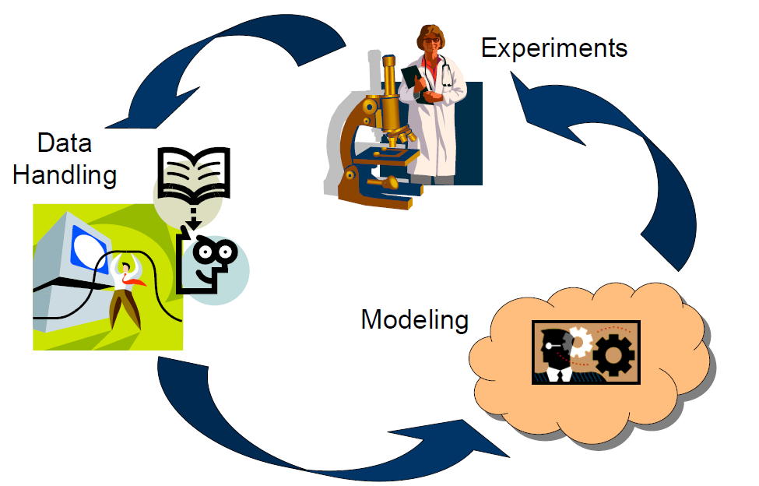
Iterative process

Slide 28
Steps for building models
Objectives
Framework definition
A priori knowledge
Analysis
Structure Characterization
EXPERIMENTAL DESIGN
Data
PARAMETERS ESTIMATION
Validation
MODEL

Slide 29
VI. Relevant issues to take into account

Slide 30
All models are wrong…
…but some are useful [Box, 1976]

Slide 31
Relevant issues
Models are an incomplete description of the reality
Their accuracy and scope define how and where we can use them with confidence
They can help us define new areas of research and development
Useful models in engineering require the estimation of model parameters using experimental data
Model parameters should be identifiable

Slide 32
Relevant issues
We should look for models that follow the parsimony principle (Occam’s razor), i.e., they should describe the problem accurately in the simplest possible way. It also means that the model should contain the minimum number of estimated parameters
Normally, first principles models are more reliable, easy to interpret and easy to extrapolate than empirical (black box) models
Developing mathematical models is considered an activity that combines science and art

Slide 33
Relevant issues
Which is the difference between a system of differential and algebraic equations (DAE) and a mathematical model?
The purpose

Slide 34
Models of interest for this course
Dynamic models described by non-linear ODE systems
Models that can be calibrated with experimental data
Examples will be taken from process engineering, although the techniques that we will discuss are applicable to any system described by ODEs

Slide 35
VII. Example of process engineering models

Slide 36
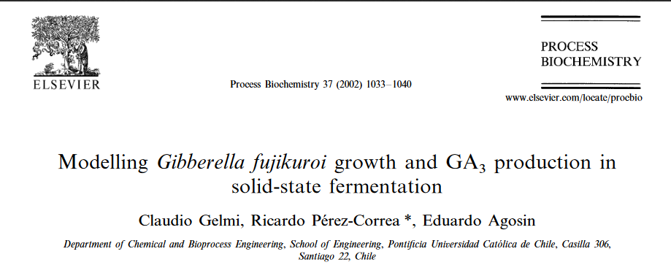
Solid Substrate Fermentation Model
Characteristics of the model:
behavior of a filamentous fungus that produces a growth hormone for agronomic applications; reduced to 8 ODEs (ordinary differential equations)
it predicts the evolution of the process in glass columns under certain conditions

Slide 37
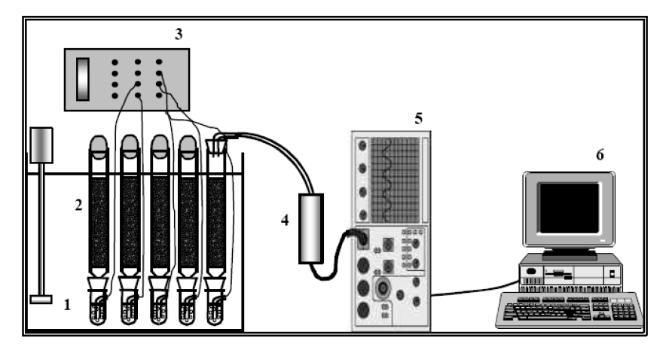
Monitoring and data acquisition
Monitoring and on-line data acquisition system: (1) temperature regulation system; (2) glass columns; (3) inlet air pressure regulator; (4) desiccation column; (5) gas analyzer; (6) PC.

Slide 38
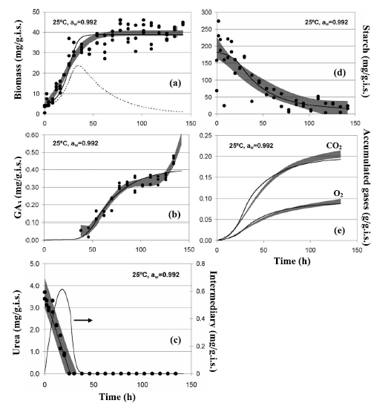
Experimental data

Slide 39
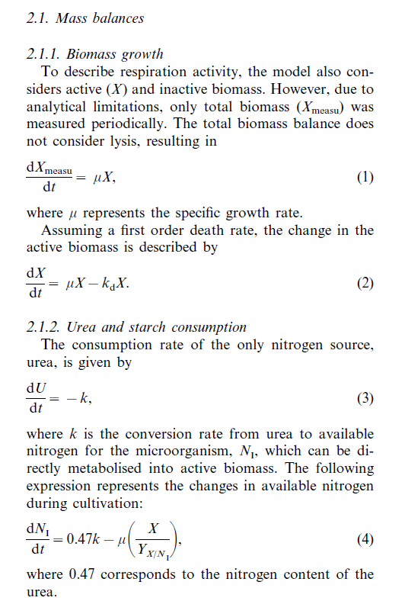
Model equations

Slide 40
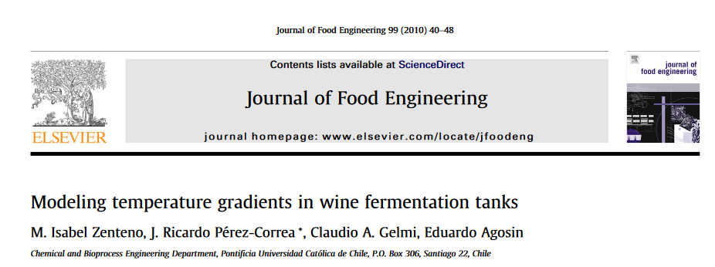
Wine fermentation
Characteristics of the model:
yeast behavior (growth, consumption, production) and temperature gradients; reduced to 11 ODEs
Predicts the temperature gradients in a 10 m³ wine fermentation tank

Slide 41
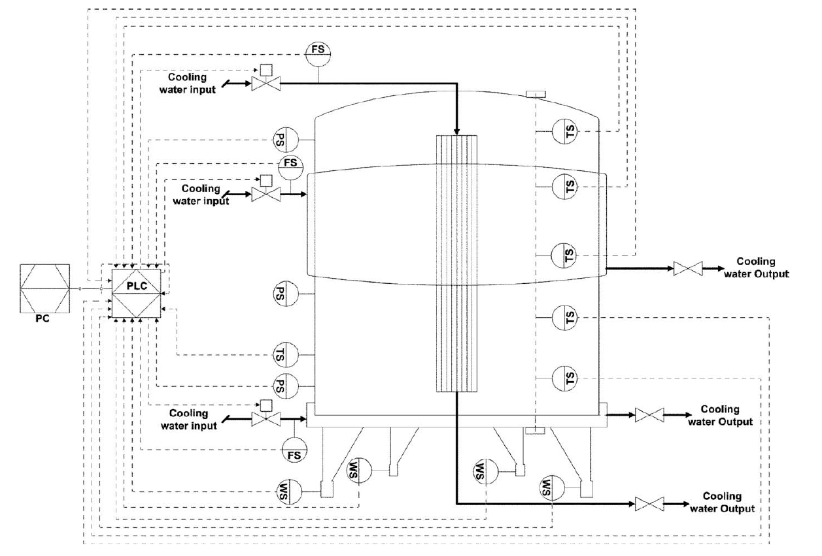
P&ID of the fermentation tank

Slide 42
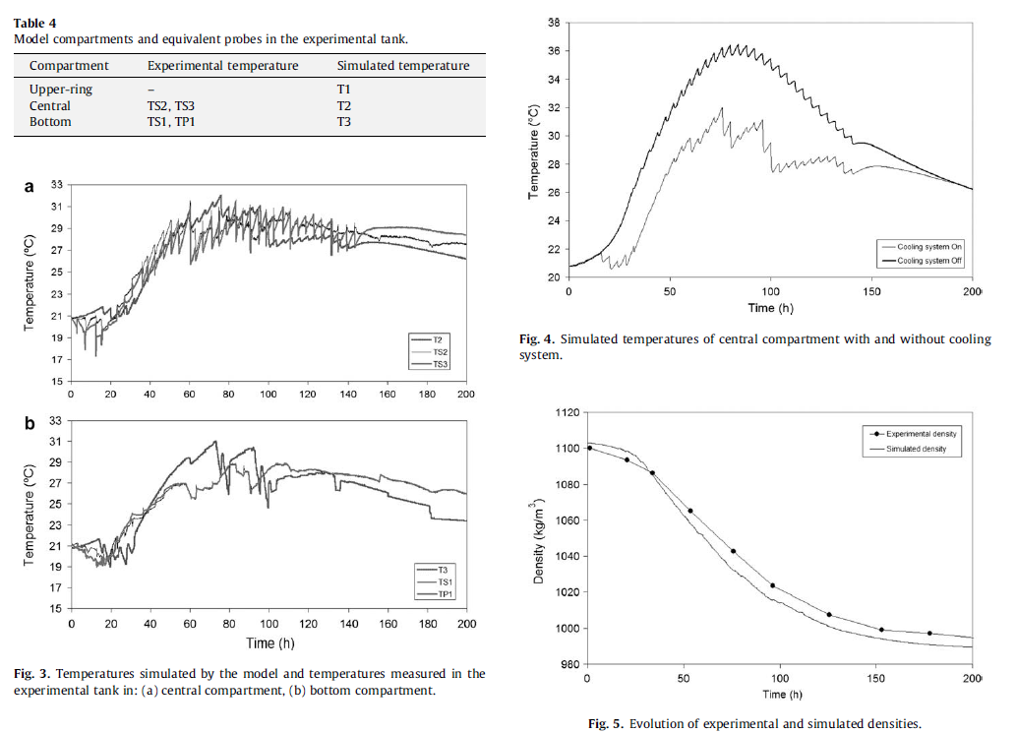
Experimental and simulated temperatures

Slide 43

Synthesis of oligosaccharides
Characteristics of the model:
Kinetic model that describes the enzymatic synthesis of oligosaccharides starting from lactulose; reduced to 9 ODEs
The model is useful to find operating conditions that maximize production

Slide 44
Enzymatic reactions
Formation of the E-Gal complex
Formation of trisaccharide
Formation of disaccharide Gal-Gal
Hydrolysis
Inhibition by galactose

Slide 45
Differential equations

Slide 46
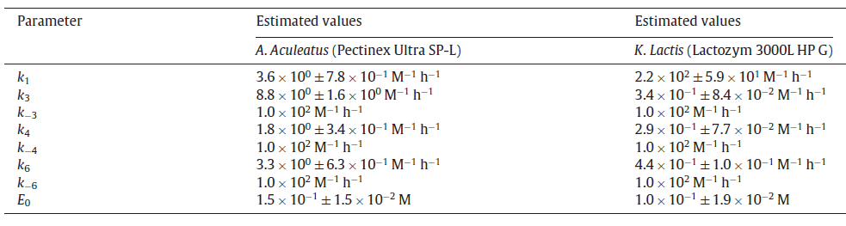
Estimated parameters

Slide 47
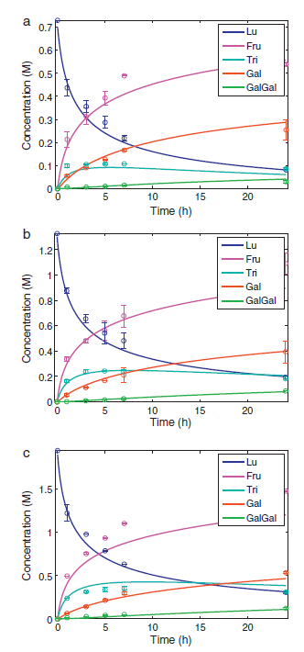
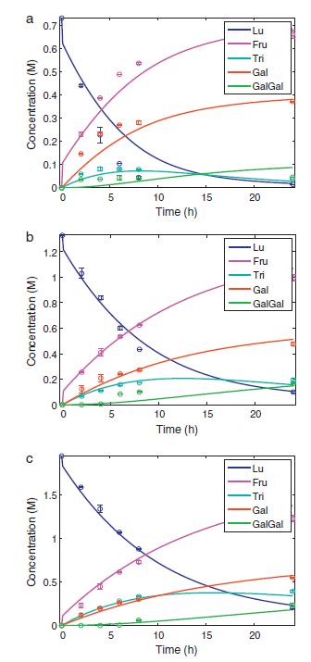
Experimental data fitting
Pectinex Ultra SP-L, T = 333 K
Lactozym 3000L HP G, T = 323 K

Slide 48
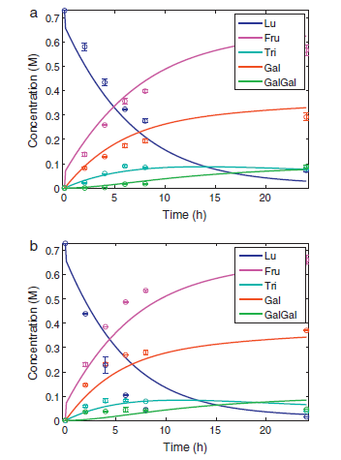
Temperature dependence
Arrhenius equation
E_{a} = activation energy de (J/mol)
K₀ = pre-exponential factor
R = ideal gases constant (8.3 J/mol K)
T = temperature (K)
Lactozym 3000L HP G, a) T = 313 K, b) T = 323 K

